Slide 1
Modeling and Mapping Smart Grid Vocabulary
1

Slide 2
Approach
Clearly define some neutral terms
HomeEnergyManagementLogicalDevice
HomeEnergyManagementLogicalServices
…
Map use case concepts to those terms
Map our vocabulary set to those terms
2

Slide 3
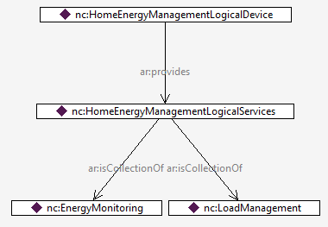
Home Energy Management Device
…is defined as something that provides HomeEnergyManagementLogicalServices
and that collection of services is defined below.
Providing the HomeEnergyManagementLogicalServices means that
you can perform all of the services in the collection.

Slide 4
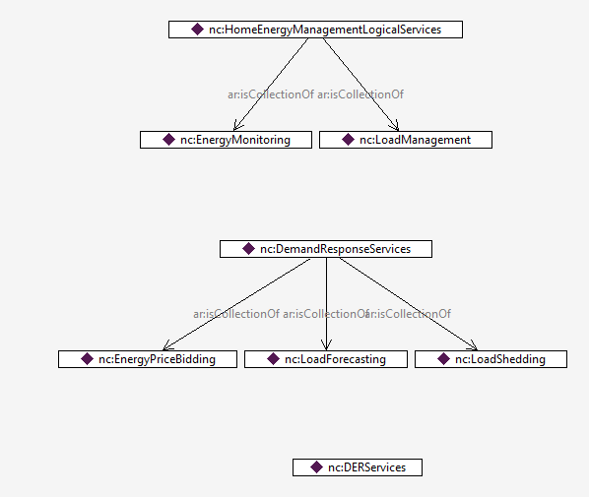
Some Logical Service Collections

Slide 5
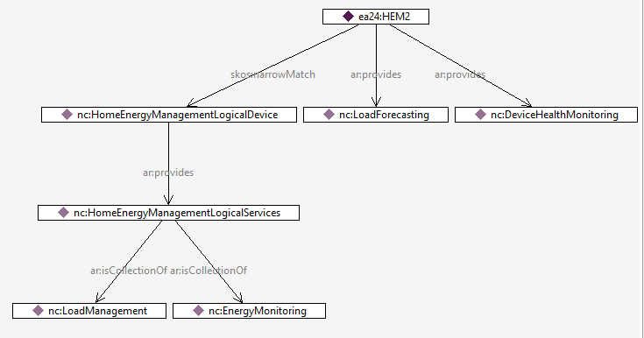
The HEM in the use case
…fulfills the definition of the HomeEnergyManagementLogicalDevice, plus
it provides the LoadForecasting service and DeviceHealthMonitoring service.

Slide 6
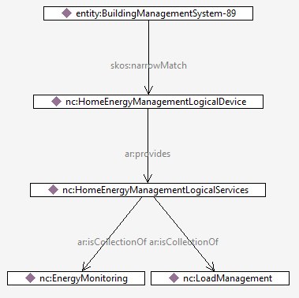
BuildingManagementSystem-89
…also fulfills the definition of the HomeEnergyManagementLogicalDevice, plus
it probably also provides other services.
How does this help? Because if you want to interface with something that is a
skos:narrowMatch to a HomeEnergyManagementLogicalDevice, then you are
guaranteed that it can perform LoadManagement (for example).

Slide 7
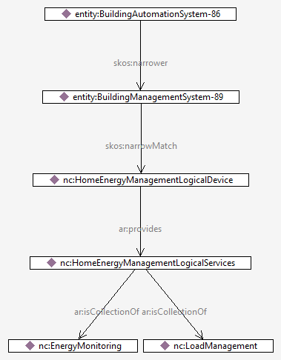
BuildingAutomationSystem-86
…is also guaranteed to do LoadManagement, because in this example it can do everything BuildingManagementSystem-89 can do, plus possibly more.

Slide 8
Implications
If we correctly categorize systems and services, we can begin to identify where interoperability is possible, and where there will be problems.

